Slide 1
NYC Citywide Payroll
Data Analysis
Agency Compensation & Data Science Salary Analysis
Fiscal Year 2025 | NYC OpenData | Office of Payroll Administration
Shawn Ganz

Slide 2
Research Questions
Guiding the analysis of NYC payroll data
01
Which agencies spend the most on employee compensation?
Analyzing total base salary expenditure across all NYC agencies
02
Which agencies have the highest average salaries?
Comparing mean base salary across agencies with 50+ employees
03
Among data science-related titles, which agencies offer the highest compensation?
Focusing on Data Analyst, City Research Scientist, Research Scientist, Statistician, and IT Project Specialist
As a City of New York employee, I’m personally interested in understanding the salary landscape across agencies and how data-focused roles compare.

Slide 3
Data Source & Methodology
NYC OpenData • Office of Payroll Administration
PRIMARY DATASET
Citywide Payroll Data
Published by NYC’s Office of Payroll Administration (OPA) through the NYC OpenData portal. Includes payroll records for all city employees across every agency.
data.cityofnewyork.us
KEY FIELDS ANALYZED
• Agency Name
• Civil Service Title
• Base Salary
• Pay Basis (Annual)
• Fiscal Year
• Employee Count
SELECTED CIVIL SERVICE TITLES FOR DATA SCIENCE ANALYSIS
Data Analyst • City Research Scientist • Research Scientist • Statistician • IT Project Specialist
These titles were chosen as the closest matches to data science roles within NYC’s civil service classification system. Analysis also includes a broader set of similar data, analytics, and IT-related titles for comparison.

Slide 4
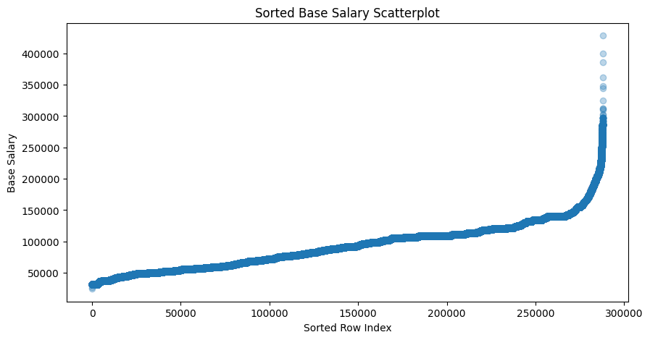
Total Base Salary Overview
Fiscal Year 2025 Summary
Source: NYC OpenData – Office of Payroll Administration | Fiscal Year 2025

Slide 5
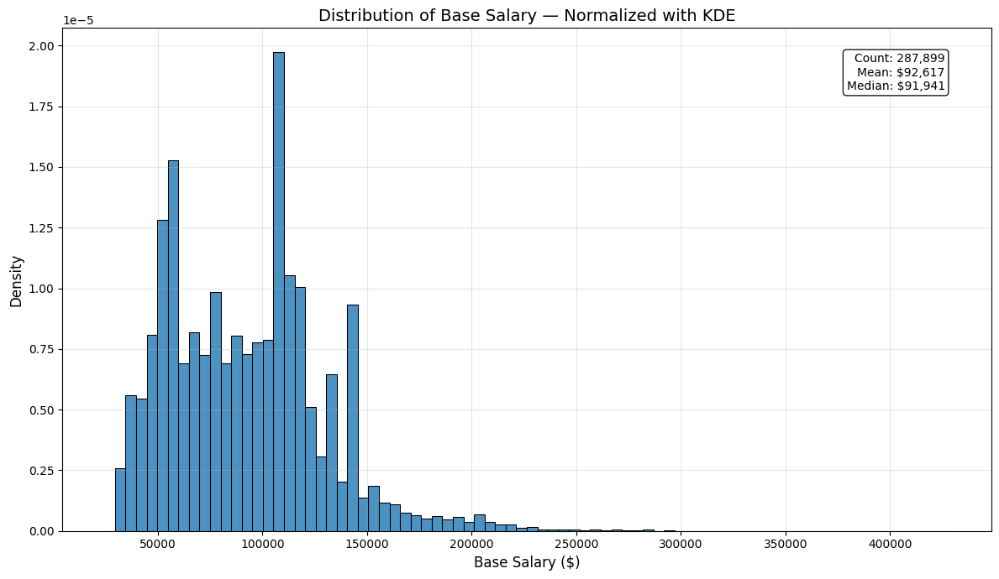
Base Salary Distribution
Normalized with KDE
Source: NYC OpenData – Office of Payroll Administration | Fiscal Year 2025

Slide 6
PART 1
Which agencies drive the citywide payroll budget?
Total base salary expenditure across all NYC agencies
Salary distribution patterns among ~288,000 employees
Identifying the top 10 agencies by total compensation spend

Slide 7
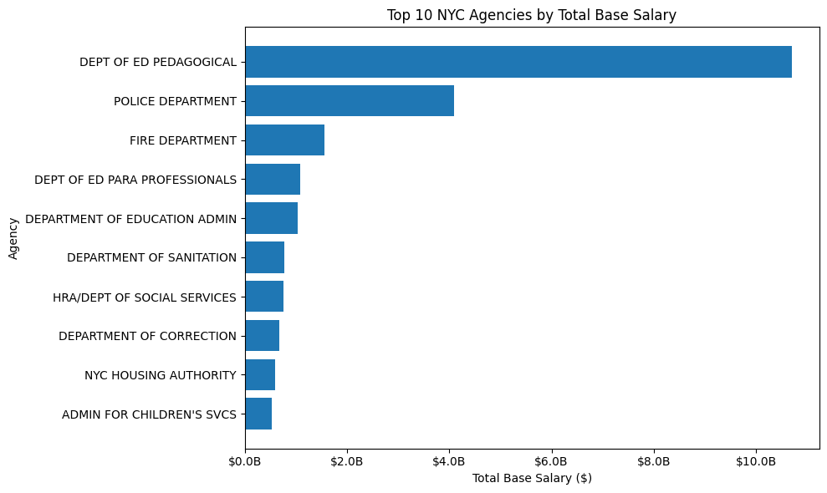
Top 10 Agencies by Total Base Salary
Active Annual Employees
Source: NYC OpenData – Office of Payroll Administration | Fiscal Year 2025

Slide 8
Top 10 Agencies by Total Base Salary
Fiscal Year 2025 • Active Annual Employees
Agency | Total Base Salary | Mean Salary | Median Salary | Employees
Dept of Ed Pedagogical | $10,704,877,902 | $111,322 | $110,848 | 96,161
Police Department | $4,085,904,654 | $90,697 | $109,352 | 45,050
Fire Department | $1,560,078,359 | $91,894 | $109,352 | 16,977
Dept of Ed Para Professionals | $1,083,075,708 | $43,333 | $44,420 | 24,994
Dept of Education Admin | $1,042,951,881 | $85,642 | $82,370 | 12,178
Dept of Sanitation | $777,856,362 | $86,843 | $92,093 | 8,957
HRA/Dept of Social Services | $757,657,142 | $71,208 | $61,376 | 10,640
Dept of Correction | $679,180,443 | $99,924 | $105,146 | 6,797
NYC Housing Authority | $597,815,565 | $70,848 | $54,200 | 8,438
Admin for Children’s Svcs | $528,408,816 | $83,332 | $70,156 | 6,341
Source: NYC OpenData – Office of Payroll Administration | Fiscal Year 2025

Slide 9
PART 2
Controlling for size: which agencies pay the most per employee?
Filtering to agencies with 50+ employees for meaningful comparison
Ranking by average base salary rather than total spend
Revealing which smaller, specialized agencies offer the highest pay

Slide 10
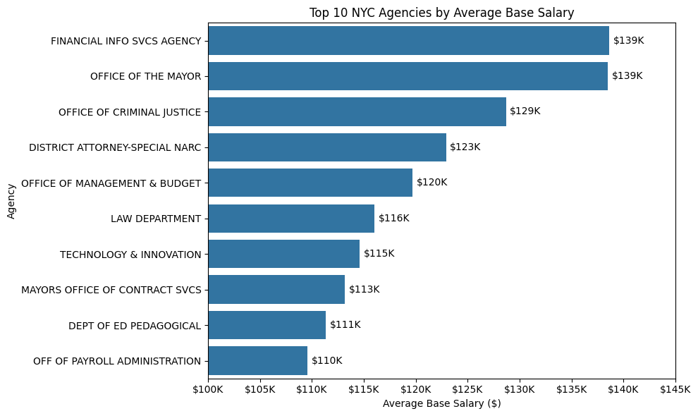
Top 10 Agencies by Average Base Salary
Agencies with 50+ Employees
Source: NYC OpenData – Office of Payroll Administration | Fiscal Year 2025

Slide 11
Top 10 Agencies by Average Base Salary
Active Annual Employees • Agencies with 50+ Employees
Agency | Mean Salary | Median Salary | Total Base Salary | Employees
Financial Info Svcs Agency | $138,654 | $143,540 | $54,074,875 | 390
Office of the Mayor | $138,506 | $122,400 | $45,430,084 | 328
Office of Criminal Justice | $128,679 | $121,916 | $12,353,187 | 96
District Attorney-Special Narc | $122,914 | $107,000 | $24,091,151 | 196
Office of Management & Budget | $119,713 | $101,434 | $50,399,091 | 421
Law Department | $116,048 | $101,030 | $156,200,685 | 1,346
Technology & Innovation | $114,599 | $112,057 | $169,491,865 | 1,479
Mayors Office of Contract Svcs | $113,163 | $102,570 | $20,369,255 | 180
Dept of Ed Pedagogical | $111,322 | $110,848 | $10,704,877,902 | 96,161
Off of Payroll Administration | $109,573 | $100,684 | $14,354,005 | 131
Source: NYC OpenData – Office of Payroll Administration | Fiscal Year 2025

Slide 12
PART 3
Narrowing the focus to data science-related titles
Comparing compensation for five core civil service titles across agencies
Expanding to similar data, analytics, and IT roles for context
Understanding where data professionals are paid the most

Slide 13
PART 3
Core Data:
CITY RESEARCH SCIENTIST
IT PROJECT SPECIALIST
STATISTICIAN

Slide 14
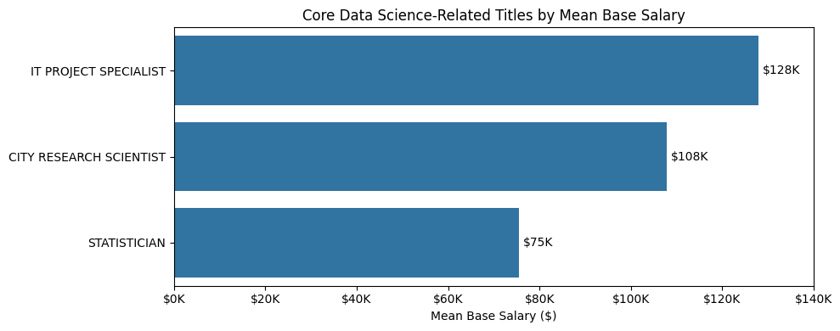
Core Data Science Titles: Salary Comparison
Mean Base Salary by Civil Service Title
Source: NYC OpenData – Office of Payroll Administration | Fiscal Year 2025

Slide 15
Core Data Science Titles: Salary Breakdown
Mean Base Salary by Civil Service Title
Title | Mean Salary | Median Salary | Employees
IT Project Specialist | $127,877 | $127,830 | 288
City Research Scientist | $107,782 | $106,396 | 1,513
Statistician | $75,429 | $74,926 | 4
Source: NYC OpenData – Office of Payroll Administration | Fiscal Year 2025

Slide 16
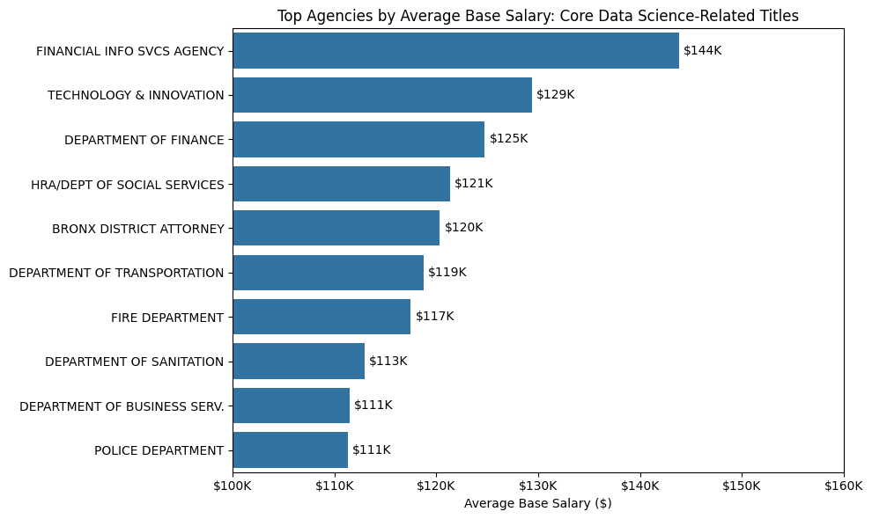
Core Data Science Titles by Agency
Highest-Paying Agencies for Selected Civil Service Titles
Source: NYC OpenData – Office of Payroll Administration | Fiscal Year 2025

Slide 17
Core Data Science Titles: Top Agencies
Highest-Paying Agencies for Selected Civil Service Titles
Agency | Mean Salary | Median Salary | Employees | Total Base Salary
Financial Info Svcs Agency | $143,802 | $140,913 | 14 | $2,013,225
Technology & Innovation | $129,353 | $130,053 | 47 | $6,079,598
Department of Finance | $124,711 | $112,883 | 21 | $2,618,936
HRA/Dept of Social Services | $121,323 | $125,505 | 189 | $22,930,129
Bronx District Attorney | $120,344 | $123,900 | 11 | $1,323,787
Dept of Transportation | $118,721 | $114,438 | 30 | $3,561,642
Fire Department | $117,483 | $117,194 | 17 | $1,997,207
Dept of Sanitation | $112,926 | $105,428 | 12 | $1,355,111
Dept of Business Serv. | $111,446 | $111,665 | 10 | $1,114,461
Police Department | $111,282 | $109,232 | 39 | $4,339,980
Source: NYC OpenData – Office of Payroll Administration | Fiscal Year 2025

Slide 18
PART 3
Similar Data:
CITY RESEARCH SCIENTIST
IT PROJECT SPECIALIST
STATISTICIAN
BUSINESS RESEARCH & DATA ANALYTICS SPECIALIST
BUSINESS DATA AND REPORTING ANALYST
CRIME ANALYST
CYBER SECURITY ANALYST
IT SECURITY SPECIALIST
SENIOR IT ARCHITECT
IT INFRASTRUCTURE ENGINEER
IT AUTOMATION AND MONITORING ENGINEER
COMPUTER PROGRAMMER ANALYST
COMPUTER SPECIALIST
COMPUTER ASSOCIATE
ADMINISTRATIVE STAFF ANALYST
ASSOCIATE STAFF ANALYST
STAFF ANALYST
CERTIFIED IT DEVELOPER
DATA ANALYST
SENIOR DATA ANALYST

Slide 19
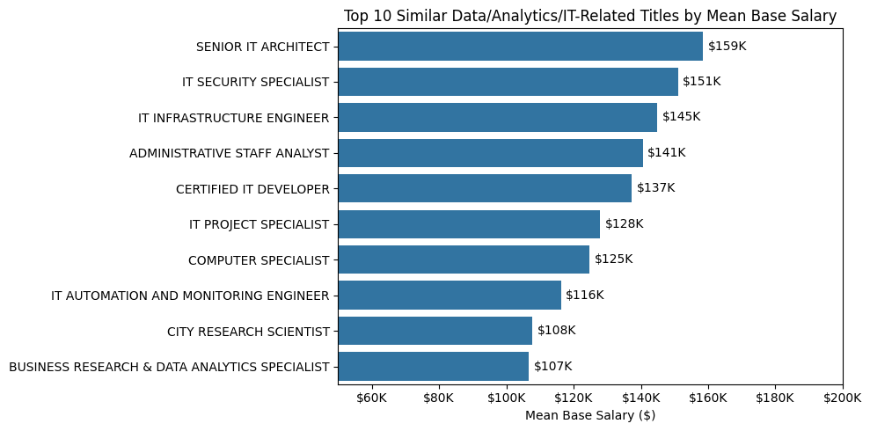
Similar Titles: Salary Comparison
Top 10 Data/Analytics/IT Titles by Mean Base Salary
Source: NYC OpenData – Office of Payroll Administration | Fiscal Year 2025

Slide 20
Similar Titles: Salary Breakdown
Top 10 Data/Analytics/IT Titles by Mean Base Salary
Title | Mean Salary | Median Salary | Employees
Senior IT Architect | $158,566 | $158,290 | 70
IT Security Specialist | $151,028 | $152,313 | 98
IT Infrastructure Engineer | $144,911 | $147,877 | 50
Administrative Staff Analyst | $140,589 | $128,640 | 1,887
Certified IT Developer | $137,319 | $138,368 | 224
IT Project Specialist | $127,877 | $127,830 | 288
Computer Specialist | $124,830 | $123,208 | 1,248
IT Automation & Monitoring Engineer | $116,261 | $117,474 | 50
City Research Scientist | $107,782 | $106,396 | 1,513
Business Research & Data Analytics Specialist | $106,643 | $100,904 | 31
Source: NYC OpenData – Office of Payroll Administration | Fiscal Year 2025

Slide 21
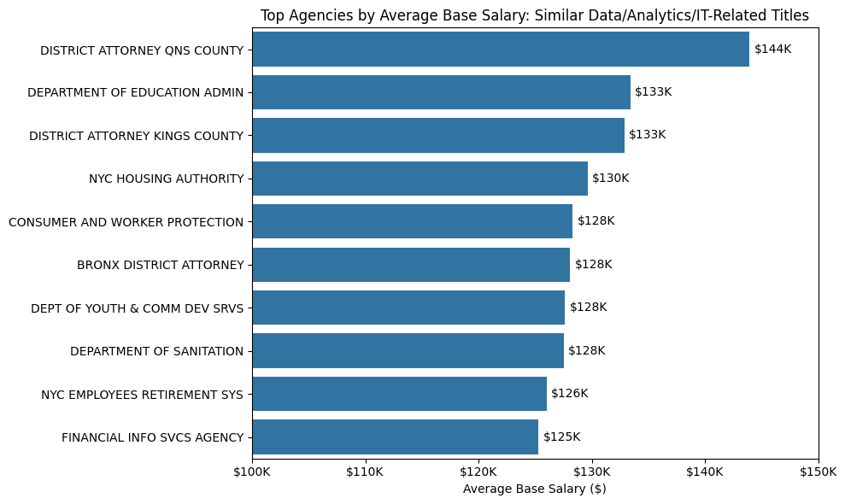
Similar Data/Analytics Titles by Agency
Related IT and Research Positions
Source: NYC OpenData – Office of Payroll Administration | Fiscal Year 2025

Slide 22
Similar Data/Analytics Titles: Top Agencies
Related IT and Research Positions
Agency | Mean Salary | Median Salary | Employees | Total Base Salary
District Attorney Qns County | $143,925 | $138,846 | 18 | $2,590,650
Dept of Education Admin | $133,385 | $132,170 | 514 | $68,560,037
District Attorney Kings County | $132,872 | $129,624 | 13 | $1,727,342
NYC Housing Authority | $129,626 | $118,421 | 239 | $30,980,635
Consumer and Worker Protection | $128,305 | $121,650 | 45 | $5,773,738
Bronx District Attorney | $128,069 | $132,934 | 25 | $3,201,720
Dept of Youth & Comm Dev Srvs | $127,630 | $123,208 | 94 | $11,997,252
Dept of Sanitation | $127,509 | $120,524 | 156 | $19,891,478
NYC Employees Retirement Sys | $125,994 | $120,468 | 46 | $5,795,711
Financial Info Svcs Agency | $125,269 | $128,206 | 146 | $18,289,308
Source: NYC OpenData – Office of Payroll Administration | Fiscal Year 2025

Slide 23
Key Findings
Q1 • WHICH AGENCIES SPEND THE MOST ON COMPENSATION?
Dept of Ed Pedagogical leads at $10.7B — more than the next three agencies combined.
Total spend is driven by headcount (96K employees), not high individual salaries. Police and Fire round out the top three.
Q2 • WHICH AGENCIES HAVE THE HIGHEST AVERAGE SALARIES?
Financial Info Svcs Agency tops the list at $139K average — smaller agencies pay more per employee.
The Office of the Mayor ($139K) and Office of Criminal Justice ($129K) follow. Technical and policy-focused agencies command a premium.
Q3 • WHICH AGENCIES PAY DATA SCIENCE ROLES THE MOST?
Financial Info Svcs Agency again leads at $144K — agency choice matters more than title alone.
Technology & Innovation ($129K) and Dept of Finance ($125K) follow. The same title can vary by $30K+ depending on agency.
NYC Citywide Payroll Data Analysis | Fiscal Year 2025 | NYC OpenData

